Slide 1
Introduction to R

Slide 2
Introduction to R
Open Source Programming Language
Statistical Software and Data Analysis tool
Interface
Command line user interface
Found in all platforms
IDE for R – RStudio

Slide 3
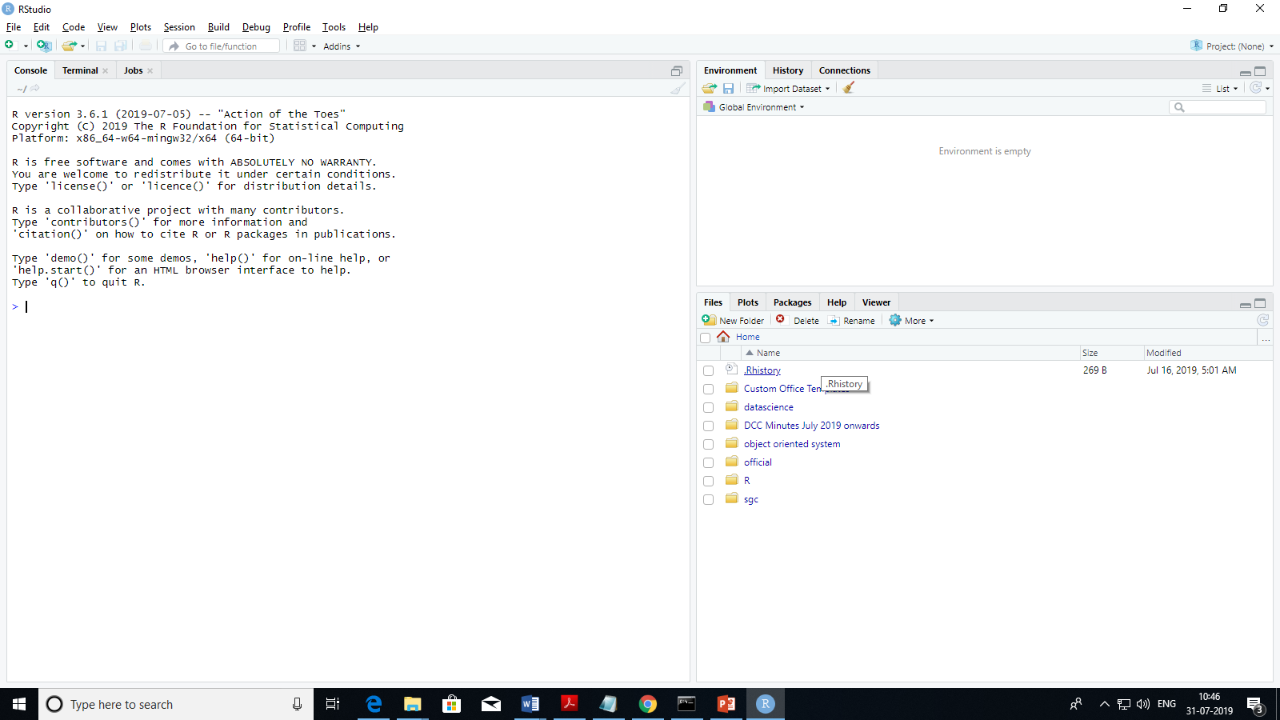
Console
Environment /History
Files / Plots /Packages /Help / Viewer

Slide 4
Set working directory
Setwd (“directorypath” or using GUI
Opening a file as script

Slide 5
Adding comments
Improve readability
Purpose of code
Explain algorithm used to accomplish the purpose
To generate documentation external to the source code itself by documentation generators
To comment a single line, insert # at the start of the comment
Multiple lines
Select multiple lines using cursor then press “Ctrl + shift + C”

Slide 6
Clear the console “ Ctrl + L”
Clear the enviornemment –rm()
Single variable in console/R Script : rm(variable)
All variables rm(list=ls())
Saving data from Workspace
Is not retained after the session
If you close/restart R studio
Permanaently file –save command
Reloaded using - load

Slide 7
Save(a,feile = “S1.Rdata” #save variable a
Save(list=ls(all.names=TRUE), file = “s2.data”
Save.image () # short cut function to save whole workspace

Slide 8
Variables and Data Types in R
Variable Name
Alphanumeric , ‘_’ and ‘.’
Always start with alphabets
No other special characters
Predefined constants
Pi, letters, LETTERS, Months in a year

Slide 9
Basic Data type
Logical – True or False
Integer –
Numeric – real
Complex
Character – all alphabets and special characters “a” , “@”

Slide 10
Ta
Find the data type of object – typeof(object)
Verify if object is of a certain data type – is.data_type(object)
Change /Convert the data type of one object to another -> as. Data_type(object)
Eg. As.complex(2) >> 2+0i
As.numeric(“a”) >> NA
Is.character(“21-11-2001”) True

Slide 11
Basic Object
Vector – Ordered collection of same data types
List – Ordered collection of object
Dataframe – general tabular form data

Slide 12
Vector
An ordered collection of basic data types (same) of given length
X = C(2,3,4,5,6,7,8)

Slide 13
List
Ordered collection of objects like numeric vectors, matrix, complex vector, character array
Id= c(1,2,3,4)
emp.name = C(“man”, “” Lan:, “shan”, “dan)
Num.emp = 4
Emp.list = list(Id, emp.name, Num.emp)
print(emp.list)
All the componetns of a list can be named and can be accesed using the given names
Emp.list= list(“Id”=ID, “Names” =emp.name, “totalStaff”= num.emp) >> “man” “” Lan: “ shan” “dan
Print(emp.list$Names) or print(emplist[[1]])
Printemplist([[2]][1]) man

Slide 14
List can be modified by accessing components and replacing them.
Emp.list[“Total Staff”] = 5
Emp.list[[2]][5]= “zan”
Emp.list[[1]][5] = 5
Print(emp.list)

Slide 15
Two lists can be concatenated using the concatenation function
c(list1, list2)
Emp.ages = list(“ages” = c(23,25,23,24,22))
Emp.list= c(emp.list, emp.ages)

Slide 16
Data frames
Generic data objects storing tabular data
Matrices where each column can be of different type
Vec1 = c(1,2,3)
Vec2 = c(“R”, “Scilab”, “java”)
Vec3 = c(“for prototyping”, “for scaleup”, ‘For prototyping”)
df= data.frame(vec1,vec2,vec3)
Create from a file
newDF=read.table(path=“path of file”)
Default separator is space or u can give your version like comma , tab
newDF=read.table(path=“path of file”, sep)

Slide 17
Accessing rows and columns
df[val1,val2] referes to row “val1” and column “val2. Can be number or string or array of values like “1:2” or “c(1,3)”
df[val2] refer to column val2 only

Slide 18
subset
Subset() extracts data based on conditions

Slide 19
Edit dataframes
Dataframes an be edited by direct assignment
df[[2]][2] = “r”
Edit using edit() command
Create an instance of data frame and use edit command to open a table editor , changes can be manually made

Slide 20
Add extra rows and columns
Extra row can be added using rbind function and column using cbind
Delete rows and column
Df2=df[3,-1]
Conditional deletion
Df3= df[,!names(df)%in%c(“vec3”)
Print(df3)
Df4=df(!df$vec1==3,]

Slide 21
Manipulate rows – factor issue
When character columns are created in a dat.frame, they become factors
Factor variables are those where the character column is split into categories or factor levesl
R inbuilt datatype assignment
For character strings it takes it as only factors for the value
So in order to have new entries need to be consistent with factor levels which are fixed with the dataframe is first created.
Df= data.frame(vec1,vec2,vec3,stringsAsFactors=F)

